Slide 1
UNIT 5 : File Concepts

Slide 2
File Concept
Access Methods
Directory Structure
File-System Mounting
File Sharing
Protection

Slide 3
Objectives
To explain the function of file systems.
To describe the interfaces to file systems
To discuss file-system design tradeoffs, including access methods, file sharing, file locking, and directory structures
To explore file-system protection

Slide 4
1.) File Concept
File system provides mechanism for on-line storage of and access to both data & programs of the OS.
Consist of
  A collection of files.
  A directory structure.
The OS abstracts from physical properties of its storage devices to define a logical storage unit called file.
Contiguous logical address space
Types:
  Data
    numeric
    character
    binary
  Program
    Source ,Executable, Object

Slide 5
1.1) File Attributes
A file’s attributes vary from one OS to another but typically consist of these:
Name – only information kept in human-readable form
Identifier – unique tag (number) identifies file within file system
Type – needed for systems that support different types
Location – pointer to file location on device
Size – current file size
Protection – Access control information who can do reading, writing, executing
Time, date, and user identification – data for protection, security, and usage monitoring
Information about files are kept in the directory structure, which is maintained on the disk.

Slide 6
1.2) File Operations
File is an abstract data type
Create
Write
Read
Reposition within file
Delete
Truncate
Open(F_{i}) – search the directory structure on disk for entry F_{i}, and move the content of entry to memory
Close (F_{i}) – move the content of entry F_{i} in memory to directory structure on disk

Slide 7
Open Files
Several pieces of data are needed to manage open files:
  File pointer: pointer to last read/write location, per process that has the file open
  File-open count: counter of number of times a file is open – to allow removal of data from open-file table when last processes closes it
  Disk location of the file: cache of data access information
  Access rights: per-process access mode information

Slide 8
Open File Locking
Provided by some operating systems and file systems
Mediates access to a file
  Provide functionality similar to reader-writer locks
    Shared lock(same as reader lock)
    Exclusive lock(same as writer lock)
OS may provide Mandatory or advisory file locking system:
  Mandatory – access is denied depending on locks held and requested
  Advisory – processes can find status of locks and decide what to do

Slide 9
File Locking Example – Java API
import java.io.*;
import java.nio.channels.*;
public class LockingExample {
public static final boolean EXCLUSIVE = false;
public static final boolean SHARED = true;
public static void main(String arsg[]) throws IOException {
FileLock sharedLock = null;
FileLock exclusiveLock = null;
try {
RandomAccessFile raf = new RandomAccessFile("file.txt", "rw");
// get the channel for the file
FileChannel ch = raf.getChannel();
// this locks the first half of the file - exclusive
exclusiveLock = ch.lock(0, raf.length()/2, EXCLUSIVE);
/** Now modify the data . . . */
// release the lock
exclusiveLock.release();

Slide 10
File Locking Example – Java API (cont)
// this locks the second half of the file - shared
sharedLock = ch.lock(raf.length()/2+1, raf.length(), SHARED);
/** Now read the data . . . */
// release the lock
sharedLock.release();
} catch (java.io.IOException ioe) {
System.err.println(ioe);
}finally {
if (exclusiveLock != null)
exclusiveLock.release();
if (sharedLock != null)
sharedLock.release();
}
}
}

Slide 11
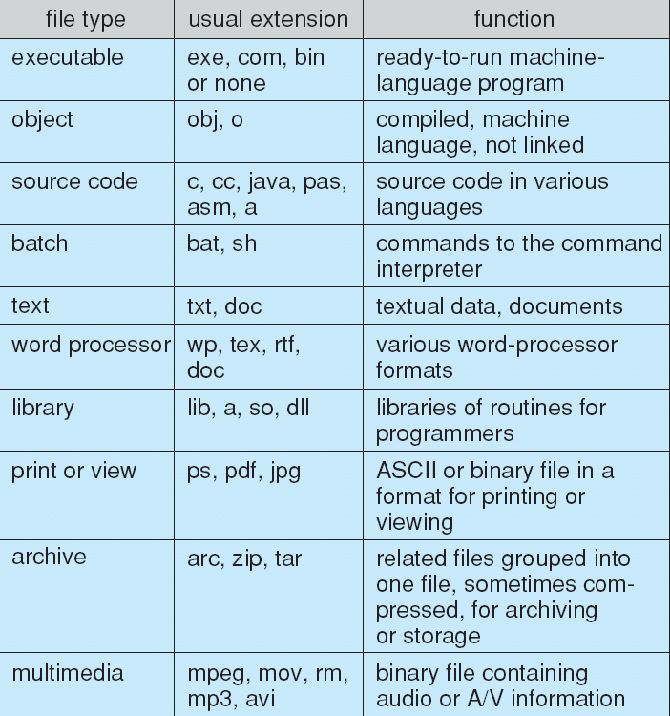
1.3) File Types – Name, Extension

Slide 12
2.) Access Methods
Files store information which need access methods to use their information
2.1) Sequential Access(processed one record after the other)
read next
write next
reset
no read after last write
(rewrite)
2.2) Direct Access(read & write records in no particular order)
read n
write n
position to n
read next
write next
rewrite n
n = relative block number

Slide 13
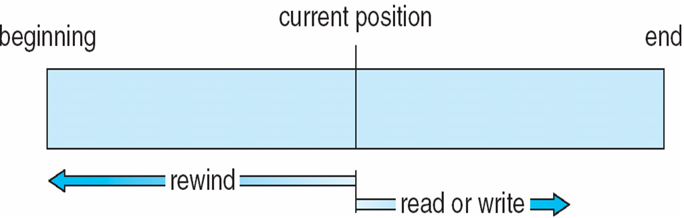
Sequential-access File

Slide 14
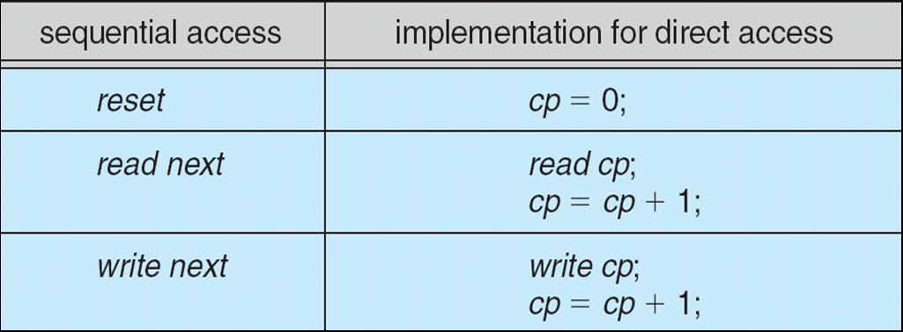
Simulation of Sequential Access on Direct-access File
Variable cp=Current Position

Slide 15
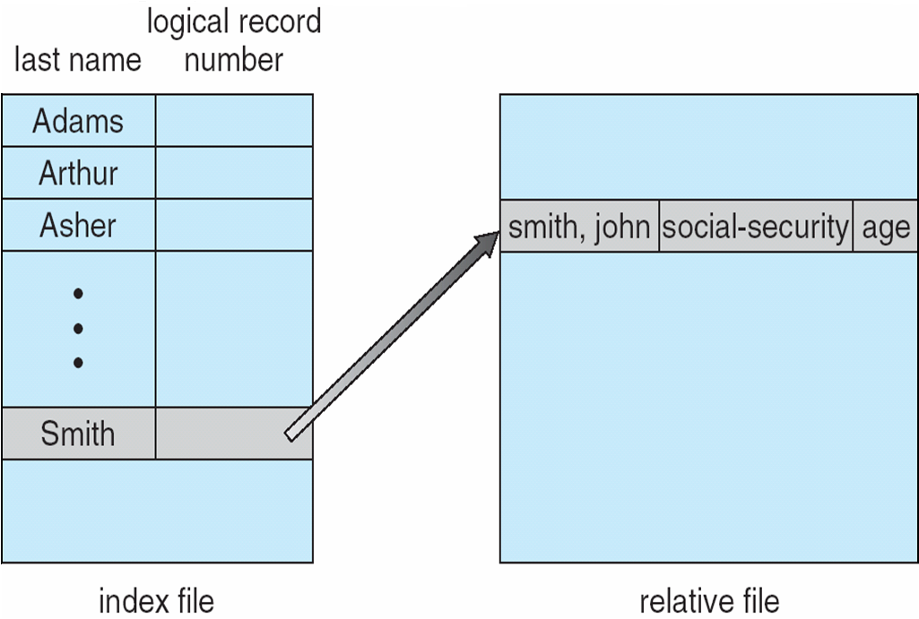
2.3) other access methods
Example of Index and Relative Files

Slide 16
3.) Directory & Disk Structure
A collection of nodes containing information about all files
Directory
Files
F 1
F 2
F 3
F 4
F n
Both the directory structure and the files reside on disk
Backups of these two structures are kept on tapes

Slide 17
Disk Structure
Disk can be subdivided into partitions
Disks or partitions can be RAID protected against failure
Disk or partition can be used raw – without a file system, or formatted with a file system
Partitions also known as minidisks, slices
Entity containing file system known as a volume
Each volume containing file system also tracks that file system’s info in device directory or volume table of contents
As well as general-purpose file systems there are many special-purpose file systems, frequently all within the same operating system or computer

Slide 18
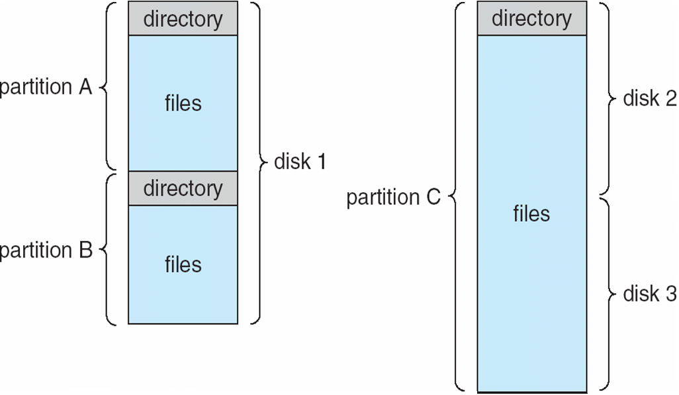
A Typical File-system Organization

Slide 19
3.2) Operations Performed on Directory
Search for a file
Create a file
Delete a file
List a directory
Rename a file
Traverse the file system

Slide 20
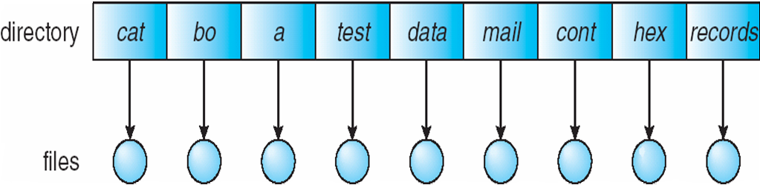
3.3) Single-Level Directory
A single directory for all users
Limitations:
Naming problem
Grouping problem

Slide 21
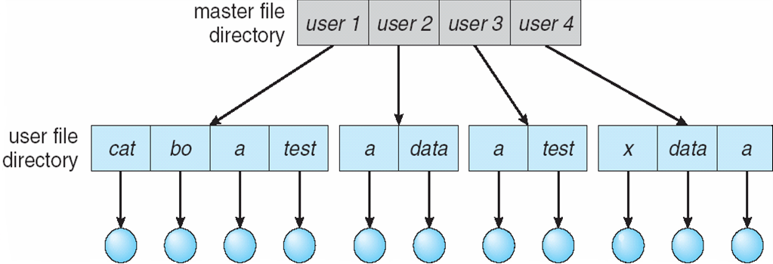
3.4) Two-Level Directory
Separate directory for each user
Path name
Can have the same file name for different user
Efficient searching
No grouping capability

Slide 22
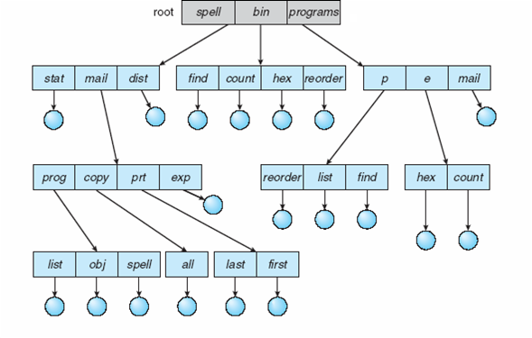
3.5) Tree-Structured Directories

Slide 23
Tree-Structured Directories (Cont)
Efficient searching
Grouping Capability
Current directory (working directory)
  cd /spell/mail/prog
  type list

Slide 24
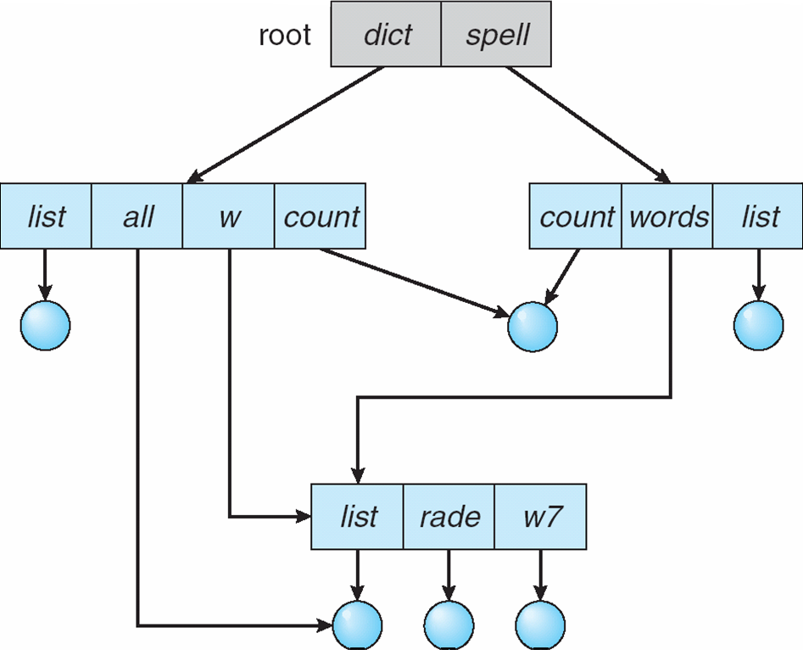
3.6) Acyclic-Graph Directories
Have shared subdirectories and files
It should ensure no cycle.

Slide 25
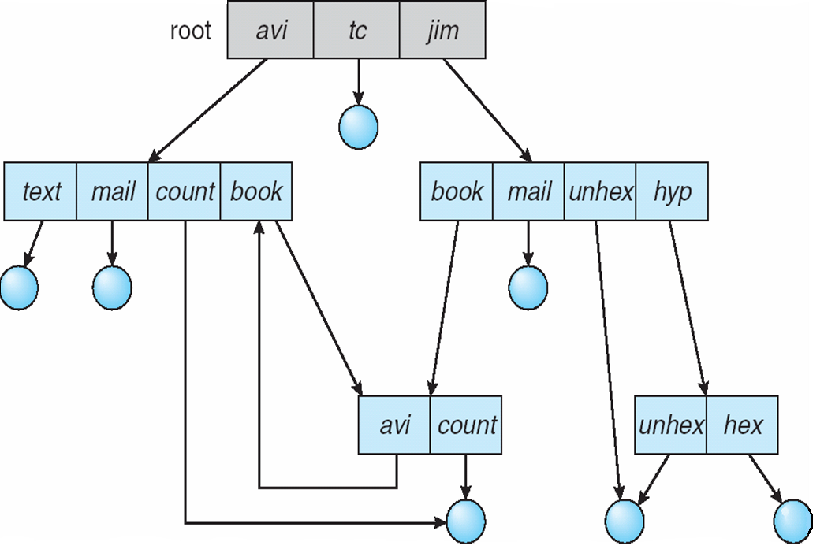
3.7) General Graph Directory

Slide 26
General Graph Directory (Cont.)
How do we guarantee no cycles?
  Allow only links to file not subdirectories
  Garbage collection
  Every time a new link is added use a cycle detection algorithm to determine whether it is OK

Slide 27
4.) File System Mounting
Just as a file must be open before it is used , a file system must be mounted before it can be accessed
A unmounted file system is mounted at a mount point( it is an empty directory).
  In UNIX system, file system containing user’s home directories might be mounted as /home .
  To access file we use /home/file name.

Slide 28
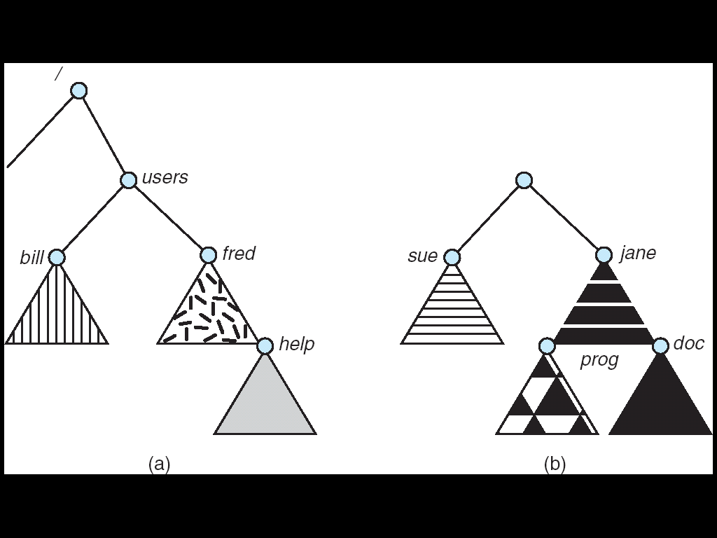
(a) Existing. (b) Unmounted Partition
Triangle : subtrees of directories

Slide 29
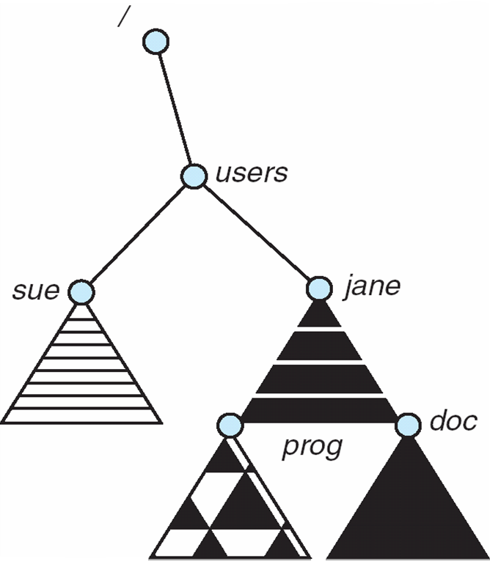
Mount Point

Slide 30
5.) File Sharing
Sharing of files on multi-user systems is desirable.
Sharing may be done through a protection scheme.
On distributed systems, files may be shared across a network.
Network File System (NFS) is a common distributed file-sharing method

Slide 31
5.1) File Sharing – Multiple Users
User IDs identify users, allowing permissions and protections to be per-user
Group IDs allow users to be in groups, permitting group access rights

Slide 32
5.2) File Sharing – Remote File Systems
Uses networking to allow file system access between systems
  Manually via programs like FTP
  Automatically, seamlessly using distributed file systems
  Semi automatically via the world wide web
Client-server model allows clients to mount remote file systems from servers
  Server can serve multiple clients
  Client and user-on-client identification is insecure or complicated
  NFS is standard UNIX client-server file sharing protocol
  CIFS is standard Windows protocol
  Standard operating system file calls are translated into remote calls
Distributed Information Systems (distributed naming services) such as LDAP, DNS, NIS, Active Directory implement unified access to information needed for remote computing

Slide 33
File Sharing – Failure Modes
Remote file systems add new failure modes, due to network failure, server failure
Recovery from failure can involve state information about status of each remote request
Stateless protocols such as NFS include all information in each request, allowing easy recovery but less security

Slide 34
File Sharing – Consistency Semantics
Consistency semantics specify how multiple users are to access a shared file simultaneously
  Similar to Ch 7 process synchronization algorithms
    Tend to be less complex due to disk I/O and network latency (for remote file systems
  Andrew File System (AFS) implemented complex remote file sharing semantics
  Unix file system (UFS) implements:
    Writes to an open file visible immediately to other users of the same open file
    Sharing file pointer to allow multiple users to read and write concurrently
  AFS has session semantics
    Writes only visible to sessions starting after the file is closed

Slide 35
Protection
File owner/creator should be able to control:
  what can be done
  by whom
Types of access
  Read
  Write
  Execute
  Append
  Delete
  List

Slide 36
Access Lists and Groups
Mode of access: read, write, execute
Three classes of users
RWX
a) owner access 7 ⇒ 1 1 1
RWX
b) group access 6 ⇒ 1 1 0
RWX
c) public access 1 ⇒ 0 0 1
Ask manager to create a group (unique name), say G, and add some users to the group.
For a particular file (say game) or subdirectory, define an appropriate access.
owner
group
public
chmod
761
game
Attach a group to a file
chgrp G game

Slide 37
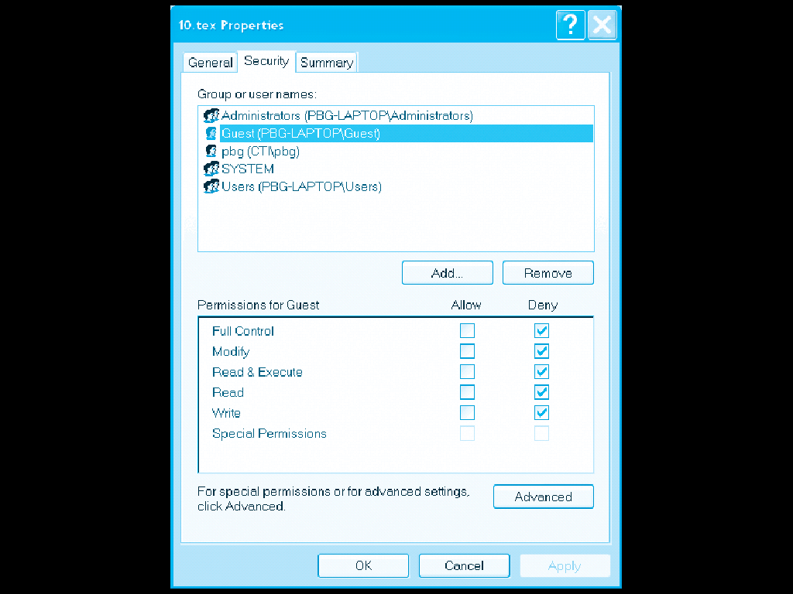
Windows XP Access-control List Management

Slide 38
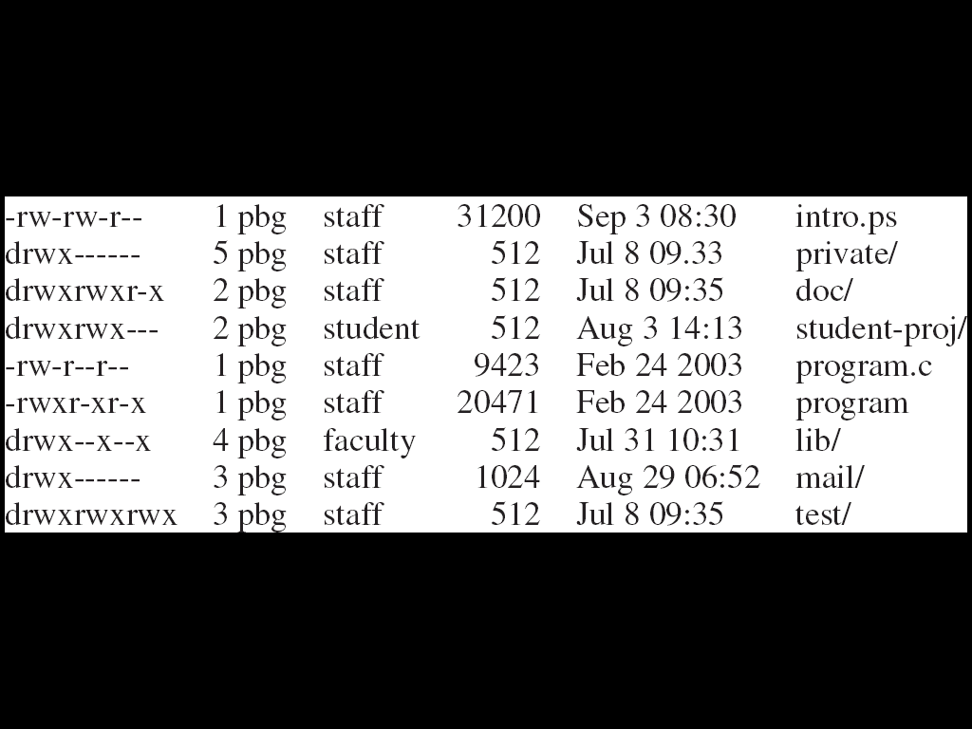
A Sample UNIX Directory Listing
http://linuxcommand.org/lts0070.php
Refer this link for more information

Slide 39
Thank You
Created By : Vaishali Jain, Assistant Professor, IT department

